Slide 1
Anonymity and Severity Analysis for Data Leakage Detection
Jay Velasco
5/6/2017

Slide 2
Outline
Introduction
K-Anonymity
L-Diversity
KL-Diversity
Discussion
Conclusion
References

Slide 3
Introduction
Data Processing
Eliminate $200 Billion in waste
Smart Cities
.5% of data is analyzed
Data Breach Severity
Number of Rows
Impact on an individual’s life
Notes:
http://www.businessinsider.com/mind-blowing-growth-and-power-of-big-data-2015-6
http://www.businessinsider.com/big-data-tackles-energy-waste-from-big-buildings-2015-5
Big Data can analyze information at a much faster rate
For example, Assessing the energy consumption of a building – The amount of time needed to assess one building can now be assessed in the thousands due to enhancements in processing Big Data
NYU’s Center for Urban Science and Progress is partnered with NYC’s Hudson Yards neighborhood in developing our nation’s first quantified community.
Tracking air quality, pedestrian traffic, energy production and consumption
.5% of data is analyzed, this number is expected to shrink
Data Breach Severity is often measured in rows, we are approaching it from the impact on an individual’s life

Slide 4
Introduction
European Union Agency for Network and Information Security
Handles information and network security for the EU
Guidelines
Prepare, Detect, Notify and Respond
Emphasis on measuring impact and severity

Slide 5
Introduction
Impact emphasis can be based on sector
Public Organization
5% decrease in stock price due to confidential data breach
Data Breaches with no confidential data had zero impact
Loss of 2.1% in market value within 2 days of disclosure

Slide 6
Introduction
Propose KL-Severity
K-Anonymity
L-Diversity
L-Severity

Slide 7
K-Anonymity
Sweeney et al.
Quasi-identifiers must occur k number of times
Q-block
Each q-block will have k number of tuples with similar quasi-identifiers
87% of individuals could be identified with their 5-digit zip code, gender and date of birth

Slide 8
K-Anonymity
Protect against inference and linkage attacks
Unintended disclosures
Individual queries may not post a risk
Linked together may disclose sensitive information

Slide 9
K-Anonymity
Generalize data by adding noise
Damage the integrity
Statistical Data
Lower classified information can leak higher classified information
Protect with a strong database design
Problem: Data replication
Multi-level databases
Suppress Data
Loses Utility

Slide 10
K-Anonymity
Each sequence of quasi-identifier values appear at least k times
Cannot link fewer than k individuals
Protects against matching to known external sources

Slide 11
K-Anonymity
Birth | Gender | Zip | Problem
1965 | M | 0214* | Short breath
1965 | M | 0214* | Chest Pain
1964 | F | 0213* | Hypertension
1964 | F | 0213* | Hypertension
1967 | M | 0213* | Chest Pain
1967 | M | 0213* | Chest Pain

Slide 12
K-Anonymity
Attacks Against K-Anonymity
Unsorted matching
Row’s index matches private table’s positions
Complementary release
Two generalized tables form a linked table
Temporal attack
New generalized table based on the same data does not consider the original released table

Slide 13
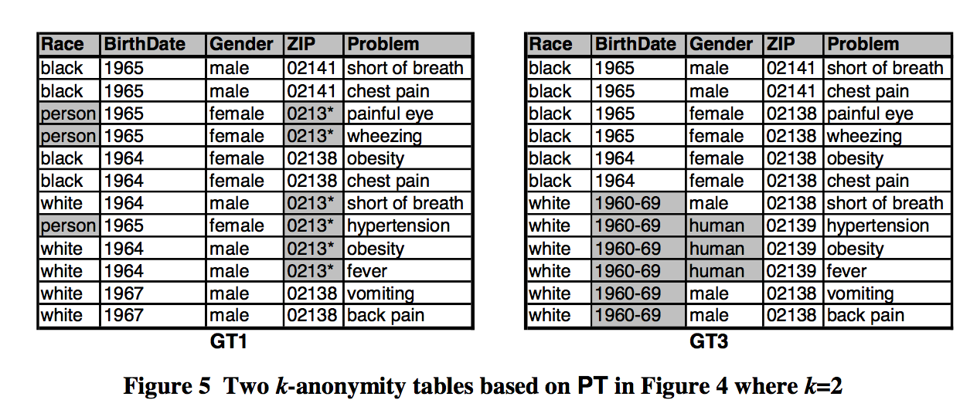
Example of a Temporal Attack
Notes:
Data should never be more specific than the original released data

Slide 14
L-Diversity
Ashwin Machanavajjhala et al.
Enhancement of K-Anonymity
Presents 2 attacks
Homogeneity
Background information

Slide 15
L-Diversity
Homogeneity
Sensitive attributes can be derived when data is not diverse enough
Background Information
Attack may have some level of background information to infer sensitive attributes
Notes:
Provide an example of each

Slide 16
Example
Birth | Gender | Zip | Problem
1965 | M | 0214* | Short breath
1965 | M | 0214* | Chest Pain
1964 | F | 0213* | Hypertension
1964 | F | 0213* | Hypertension
1967 | M | 0213* | Chest Pain
1967 | M | 0213* | Chest Pain

Slide 17
L-Diversity
Each q-block should have at least L well-represented sensitive attributes
Can protect against background knowledge
Background Knowledge
Knows the domain of each attribute
Instance Level Knowledge
Knowledge of the distribution

Slide 18
Bayes-Optimal
Models background knowledge over the attributes
Bayesian inference techniques to rationalize privacy
Strong Privacy
Assumption that the data publisher and adversary have complete knowledge of all sets of non-sensitive and sensitive attributes

Slide 19
Bayes-Optimal
Prior Belief
Background Knowledge
Posterior Belief
Knowledge after viewing the released table
Principle 1: Uninformative Principle
There should not be a large difference between the prior and posterior belief

Slide 20
Bayes-Optimal
Limitations
Data publisher and Adversary most likely has Insufficient knowledge
Adversary’s knowledge is unknown
Instance kevel knowledge
Alice knows Bob doesn’t have the chicken pox
Multiple adversaries
Attackers with different levels on knowledge

Slide 21
L-Diversity
For each q-block there are L “well represented” values
Well represented is ambiguous
Entropy L-Diversity
Higher the entropy means the more well represented the group is (uniform distribution)
Background knowledge can be protected using Recursive Diversity
(c,l) Diversity

Slide 22
L-Diversity
The following disclosures may occur when a generalized table is release
Positive Disclosure
An adversary can identify sensitive attributes with high probability
Negative Disclosure
An adversary can correctly eliminate sensitive attributes

Slide 23
L-Diversity
Positive disclosure may be allowed
Risks
Publishing unaltered tables
Separating groups can disclose information
Separating tables will be based on utility
How complex it is to understand the data
Positive Disclosure-Recursive Diversity
Non-Positive Disclosure-Recursive Diversity
Notes:
K-anonymous positive disclosure table and l-diversity sensitive attributes

Slide 24
Motivation (Recap)
L-Severity
Lack of emphasis on anonymity
Valvilis et al. suggestion
Contribution is to the severity based metric
Many metrics to use
Many factors
Insider attack/knowledge
Many Types of privacy metrics

Slide 25

L-Severity
Notes:
Sum of the record sensitivity

Slide 26

L-Severity
Notes:
Node Sensitivity – defined by data model – will go over this later

Slide 27
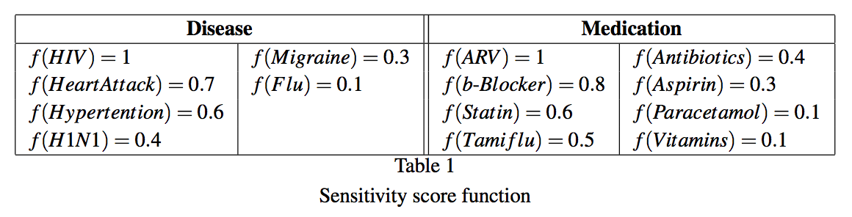
L-Severity

Slide 28
KL-Severity
K represents the number of tuples per q-block
L represents L-Severity’s well represented distinct values
Notes:
RW * [(CS/DF/DivFactor) + WR]
CS = foreach classification Add the severirites
DF = # of tuples that share the quasi-identifiers (size of q-block)
DivFactor = # of sensitive values within that q-block
WR = Well representation weight
RW = # Rows weighted
r1 < r2…rm

Slide 29
KL-Severity
Quasi-identifier
Provide scores for quasi-identfiers
Scores can be based in rules
Age < 18
Non-Sensitive Values
Classification
Number of unique sensitive values in a q-block
Well-Represented
Notes:
Released data should never be more specific than the original

Slide 30
KL-Severity
Quasi-Identifiers
Age
Specifics
Zip code: 100** vs 1009*
Gender: Male/Female vs Generalized Value
Sensitivity Score

Slide 31
KL-Severity
Job | Age | Disease
Student | 100 | HIV
Job | Age | Disease
Student | 10 | Ebola
Quasi-Identifier
f(age < 18) = .8 f(age) = .5

Slide 32
KL-Severity
Using the traditional L-Severity Model Severity would be equal
Can group quasi-identifiers with severity
Cannot provide emphasis on one over the other
Keeping all values constant except quasi-identifier values can break a tie
Notes:
Too specific

Slide 33
KL-Severity
Non-sensitive attribute
Assume Non-sensitive != quasi-identifier
Dynamic data
{ property_1: value_1 },
{ property_1: value_1, property_2: value_2 }
Notes:
Attaching constant is a good idea
Dynamic data, might not know what you’re getting/sending
Can read properties of an object
Maintenance – Forget to properly classify. Can then become a target of pulling data
Pulling from table, data is constant unless specified. If the number of attributes can change dynamically, having constant for those not accounted for can be useful
Property match to key|value pairs

Slide 34
KL-Severity
Job | Age | Disease
Student | * | HIV
Student | * | HIV
Student | * | Ebola
Student | * | HIV
Job | Age | Disease
Student | * | HIV
Student | * | Ebola
Student | * | Cancer
Student | * | Meningitis
Notes:
Homogeneity
Diversity
Well representation

Slide 35
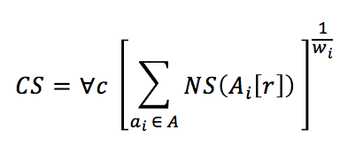
Classification Score

Slide 36
Dependency Factor
Kept logic as-is
Represents the number of tuples in a q-block
Can add a weight to determine if table follows k-anonymity rule
How far from k is this q-block
Impact
Not k-anonymity conforming
How far from k?
Equivalent to how distinct a record is using the traditional DF method
Notes:
RW * [(CS/DF/DivFactor) + WR]

Slide 37
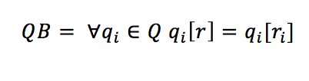
Q-Block

Slide 38
Definition
Let QBS be the set of sensitive attributes in one q-block

Slide 39

DivFactor

Slide 40

Well Represented (WR)

Slide 41
Recursive L-Diversity
Take the frequency of the most occurring sensitive attribute in a q-block
R1
R1 < R2 + …. + Rm
The most frequent sensitive value must be less than the remaining frequencies

Slide 42
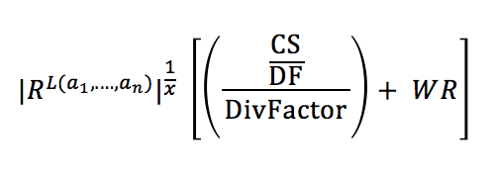
KL-Diversity

Slide 43
Example
Job | Age | Disease
Student | * | HIV
Student | * | HIV
Student | * | Ebola
Student | * | HIV
Job | Age | Disease
Student | * | HIV
Student | * | Ebola
Student | * | Cancer
Student | * | Meningitis

Slide 44
KL-Severity
Severity Definition
Impact on Individual’s life
Value
Severity should be clear and parameters will reflect this

Slide 45
KL-Severity
Job and Age QI
DF = 4
Table 1
2 DivFactor
Table 2
4 DivFactor
Assume severity is 20 for both tables

Slide 46
KL-Severity
Table 1
4 * (20 / 4 / 2) + 1
Result is 11
Table 2
4* (20 / 4 / 4) + 0
Result is 5
Table 1 is more severe!
Notes:
4 * (20 / 4 / 2) + 1
4* (20 / 4 / 4) + 0

Slide 47
KL-Diversity
L-Severity is a good foundation
DF was over generalized, but still serves as a good metric
Diversity within the sensitive attributes
We represented sensitive attributes
Weighted classifications for detailed analysis and flexibility
Acknowledgement of non-sensitive attributes

Slide 48
Future Work
Privacy Metrics
T-Closeness
Non-sensitive Attributes
Positive Disclosure L-Severity
Non-positive (negative) Disclosure L-Severity
Don’t care sets
Social Networks

Slide 49
Future Work
Experiment
Build system that implements the algorithm
Use real data
Plan scenarios
Seek Vulnerabilities

Slide 50
Limitations
Structured Data
Performance
Overfitting
Too complex
Many variables and parameters

Slide 51
Conclusion
Survey
K-Anonymity
L-Severity
M-Score
L-Diversity
Proposed improvement on Severity
KL-Severity
Future Work

Slide 52
References
Machanavajjhala, Ashwin, et al. "l-diversity: Privacy beyond k-anonymity." ACM Transactions on Knowledge Discovery from Data (TKDD) 1.1 (2007): 3.
Vavilis, Sokratis, Milan Petković, and Nicola Zannone. "A severity-based quantification of data leakages in database systems." Journal of Computer Security 24.3 (2016): 321-345.
Sweeney, Latanya. "k-anonymity: A model for protecting privacy." International Journal of Uncertainty, Fuzziness and Knowledge-Based Systems 10.05 (2002): 557-570.
Vavilis, Sokratis, Milan Petković, and Nicola Zannone. "Data leakage quantification." IFIP Annual Conference on Data and Applications Security and Privacy. Springer Berlin Heidelberg, 2014.
Goel, Sanjay, Christopher Brown, and Hany Shawky. "Measuring the impact of security breaches on stock valuations of firms." Information & Management 46.7 (2009): 404-410.
https://www.enisa.europa.eu/publications/dbn-severity
https://www.mcafee.com/it/resources/reports/rp-data-exfiltration.pdf

